Slide 1
PathFinder
Rules.xml
How to run the Ben Shell(Java Script)?
How to view the instrumented class?
How to change log level dynamically?
How to write console application to communicate with Agent(s) and Broker.

Slide 2
Rules.xml
File location : Agent folder
Priority
Agent Rules > Group Rules
Broker Rules > Agent Rules
Do we need a Rule Editor?
What can we do?

Slide 3
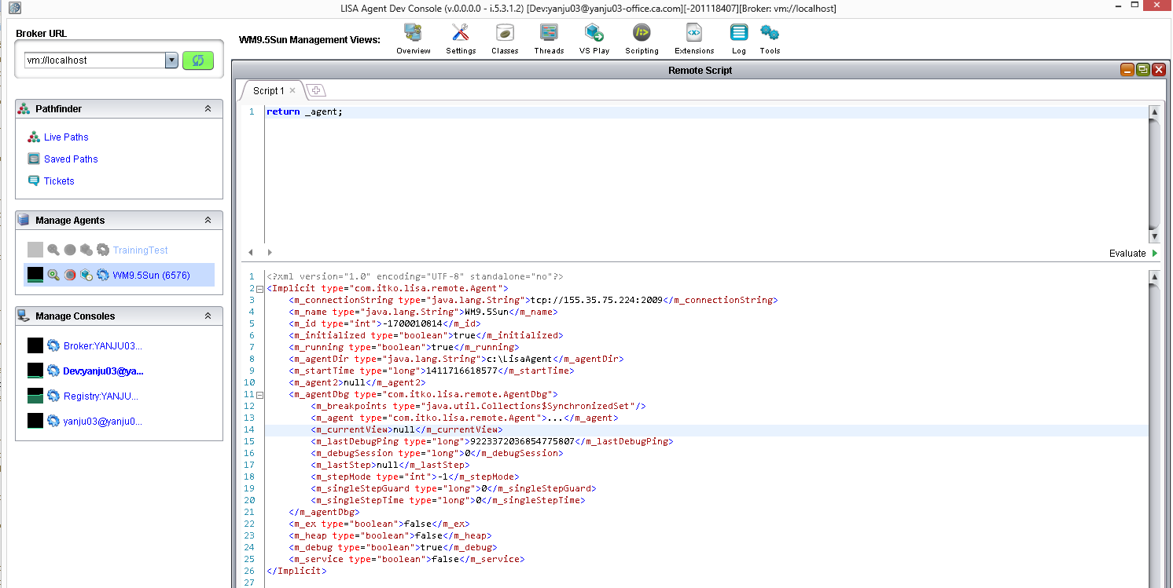
Bean Shell

Slide 4
Bean Shell
Pathfinder tests/debugs itself
How to write/Run a Java Script in PathFinder?
JMSAgentClient.onMessage()
JMSConsoleClient.onMessage()
JMSBrokerClient.onMessage()

Slide 5
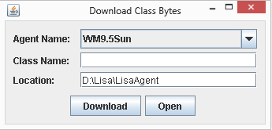
Instrumented class
Extension
Print call stack to log file

Slide 6
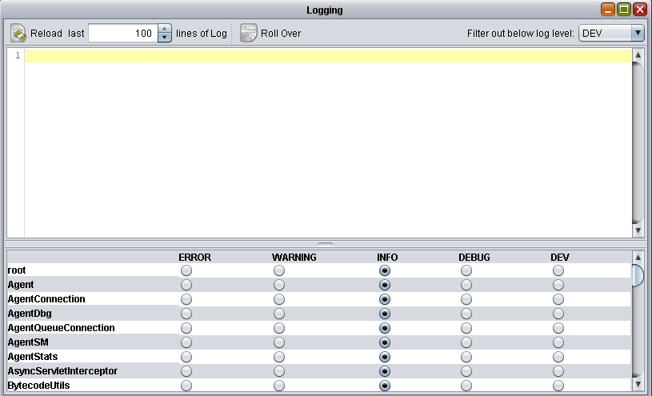
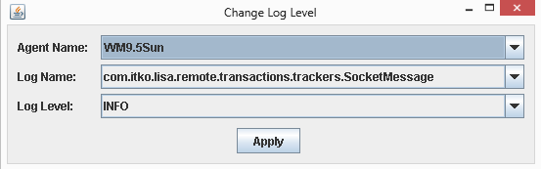
Log Level

Slide 7
Write Console Application
AgentClient.getInstance()
Change broker URL
Some important clients
Discovery Client
Transaction Client
Debugging Client
VSE Client
Ticket Client
Network Client
Logging Client

